Slide 1
SUB. CODE: UIT1401
TITLE: PRINCIPLES OF SOFTWARE ENGINEERING
Prepared By: Dr.V.Arulkumar, Asst.Prof, IT

Slide 2
COURSE OBJECTIVES
● To understand the process and its models.
● To understand fundamental concepts of requirements engineering and Analysis Modelling.
● To understand the major considerations for enterprise integration and deployment.
● To learn various testing and maintenance measures.

Slide 3
COURSE OUTCOMES
● Identify the key phases in process models.
● Compare different process models.
● Apply the concepts of requirements engineering and Analysis modelling.
● Apply systematic procedure for software design and deployment.
● Compare and contrast various testing and maintenance.

Slide 4
DATA DICTIONARIES
A data dictionary is a file or a set of files that includes a database's metadata.
The data dictionary hold records about other objects in the database, such as data ownership, data relationships to other objects, and other data.
The data dictionary is an essential component of any relational database. Ironically, because of its importance, it is invisible to most database users.
Typically, only database administrators interact with the data dictionary.
The data dictionary, in general,
    Name of the data item
    Aliases
    Description/purpose
    Related data items
    Range of values
    Data structure definition/Forms

Slide 5
The name of the data item is self-explanatory.
Aliases include other names by which this data item is called DEO for Data Entry Operator and DR for Deputy Registrar.
Description/purpose is a textual description of what the data item is used for or why it exists.
Related data items capture relationships between data items e.g., total_marks must always equal to internal_marks plus external_marks.
Range of values records all possible values, e.g. total marks must be positive and between 0 to 100.
Data structure Forms: Data flows capture the name of processes that generate or receive the data items. If the data item is primitive, then data structure form captures the physical structures of the data item. If the data is itself a data aggregate, then data structure form capture the composition of the data items in terms of other data items.

Slide 6
THE MATHEMATICAL OPERATORS -
THE DATA DICTIONARY IN THE TABL
Notations | Meaning
x=a+b | x includes of data elements a and b.
x=[a/b] | x includes of either data elements a or b.
x=a x | includes of optimal data elements a.
x=y[a] | x includes of y or more occurrences of data element a
x=[a]z | x includes of z or fewer occurrences of data element a
x=y[a]z | x includes of some occurrences of data element a which are between y and z.

Slide 7
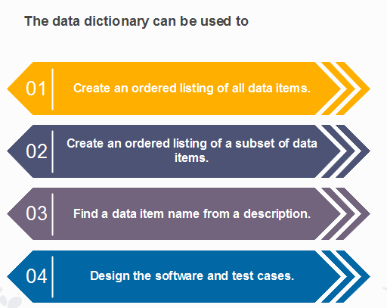
DATA DICTIONARY

Slide 8
REFERENCE
Roger S. Pressman, Software Engineering – A practitioner’s Approach, Seventh Edition, McGraw-Hill International Edition, 2010.
Ian Sommerville, Software Engineering, 9th Edition, Pearson Education Asia, 2011.

